Slide 1





FINAL PROJECT DEMONESTRATION
EEE 4518: ELECTRICAL AND ELECTRONICS LABORATORY
PROJECT TITLE: Prototype PCR Machine
Submitted by – Cor Machina
Mubeen Raisul Hassan Chowdhury
220021308
Nahid Sadique Tasin
220021115
Hussaib Hazzil Abbasi
220021104
M Faiad Faisal Sarthok
220021116
An-Nafi Ahasan
220021152
Creating Global Citizens Rooted with Islamic Values

Slide 2
Outline
Abstract
Introduction
Design
Implementation
Analysis and Evaluation
References

Slide 3
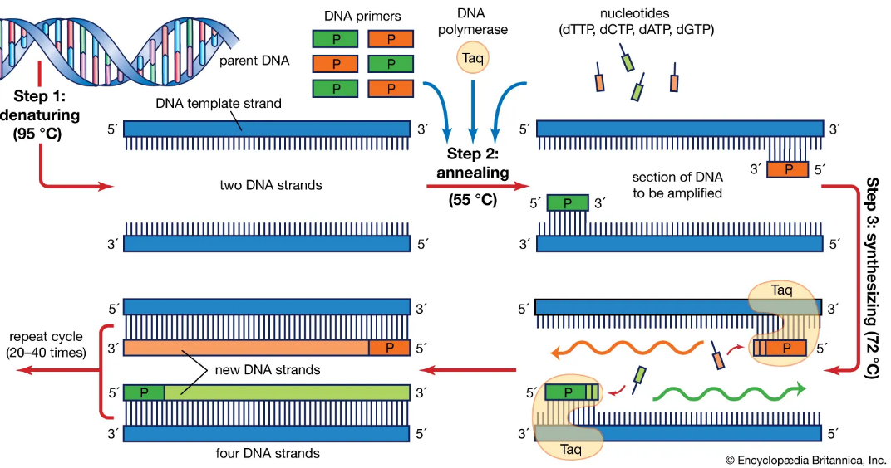
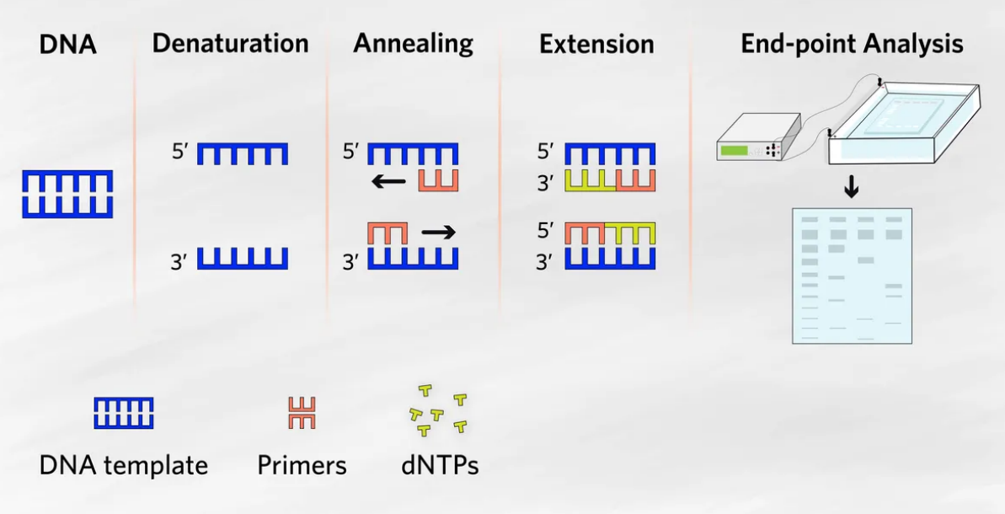
1. Abstract
PCR Machine is a laboratory device mainly used in bio-medical field. The goal of this project is to make a prototype working PCR machine within a small budget.

Slide 4
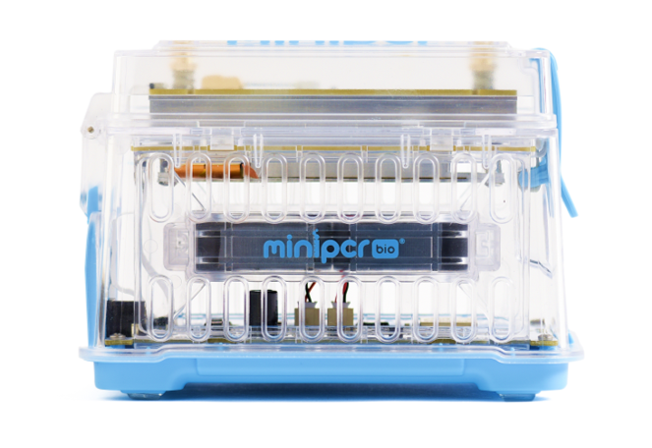
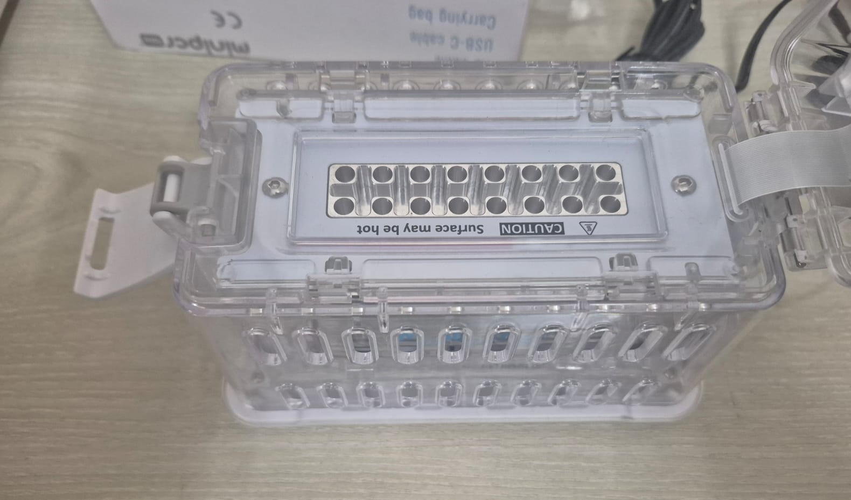
2. Introduction
Basically the Existing PCR machines has to be Imported from USA. We are trying to make a working alternative for lower cost of value. Then We tested it at a laboratory and make comparison with the commercial one.

Slide 5
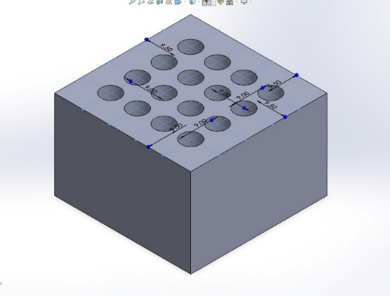
3.1 Design: Methods
Component List:
Aluminum Block for Thermal Conduction
Prototype designed in Solid Works
Holes made according to the Tube diameter and length.
Manufactured by a machinery workshop

Slide 6
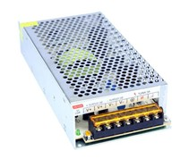
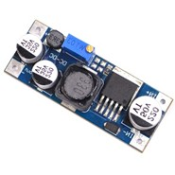
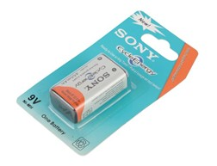
3.1 Design: Methods
Component List: (Power System)
SMPS 12V 10A
Rechargeable 9V
Buck Converter
Used for Main Power Supply
Used for Auxiliary Power Supply
To Convert the 12V supply to 9V

Slide 7
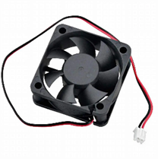
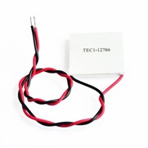
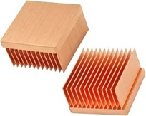
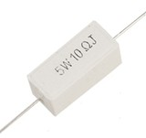
3.1 Design: Methods
Component List: (Heating and cooling System)
High Power Resistors
Thermoelectric Cooler
12V DC Fan
Heatsink
Used for Heating the Thermal Block
Used for Cooling the thermal Block

Slide 8
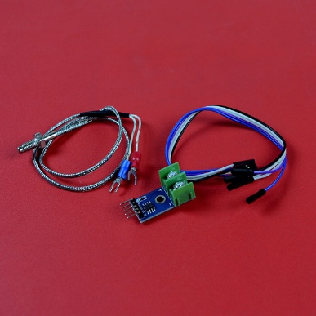
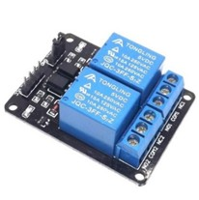
3.1 Design: Methods
Component List: (Control System)
Thermocouple Module
2 channel Relay Module
Used for Temperature Reading and feedback control
Used for Switching part of control

Slide 9
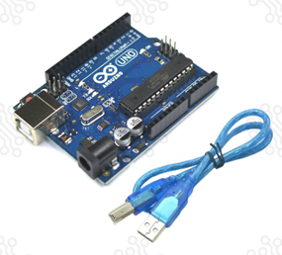
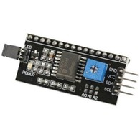
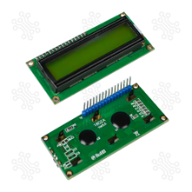
3.1 Design: Methods
Component List: (Microcontroller and LCD display)
Arduino UNO
LCD Display 16×2
I2C LCD Adapter
Used for the control mechanism
Used for the temperature and status display
Adapter for the easy use of the LCD

Slide 10
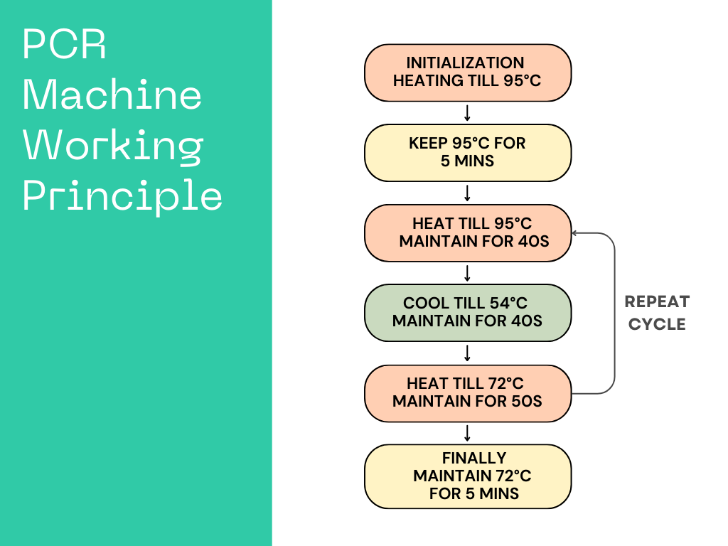
3.1 Design: Methods
Algorithm:

Slide 11
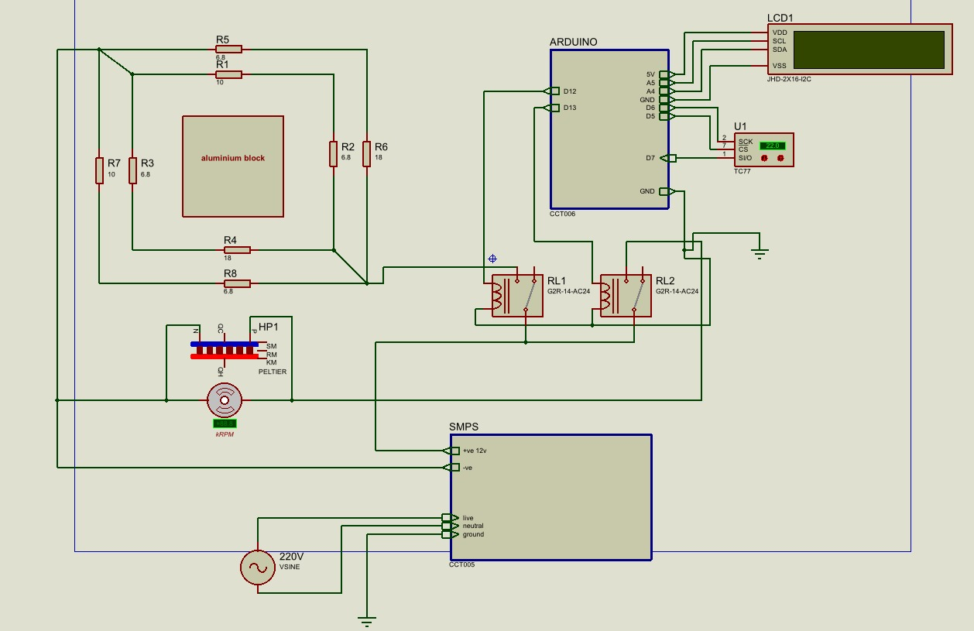
3.2 Design: Circuit Diagram

Slide 12
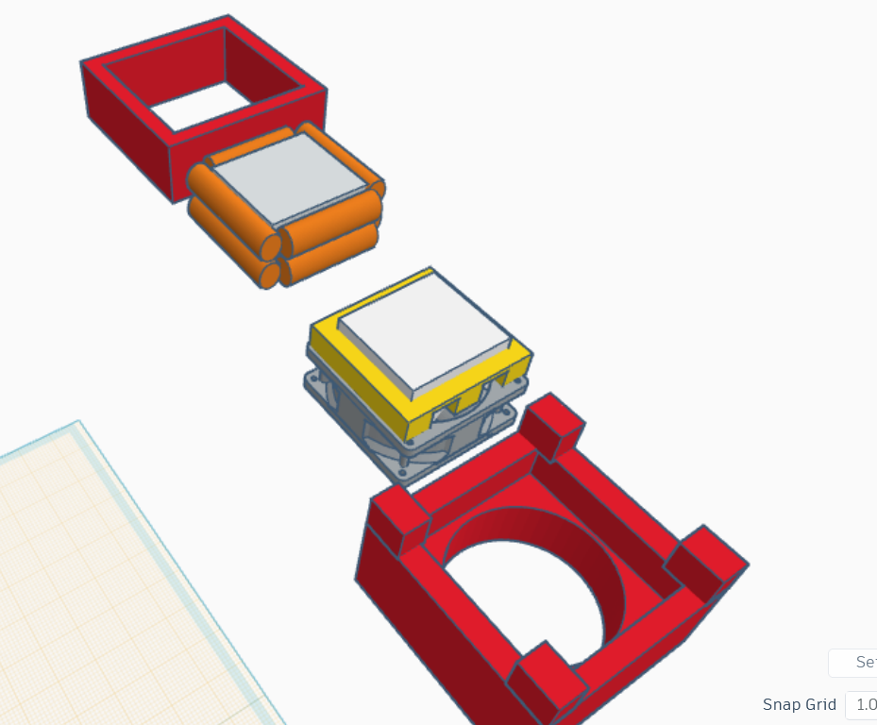
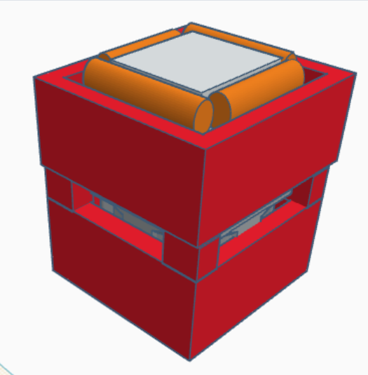
3.4 Hardware Design of the Prototype

Slide 13
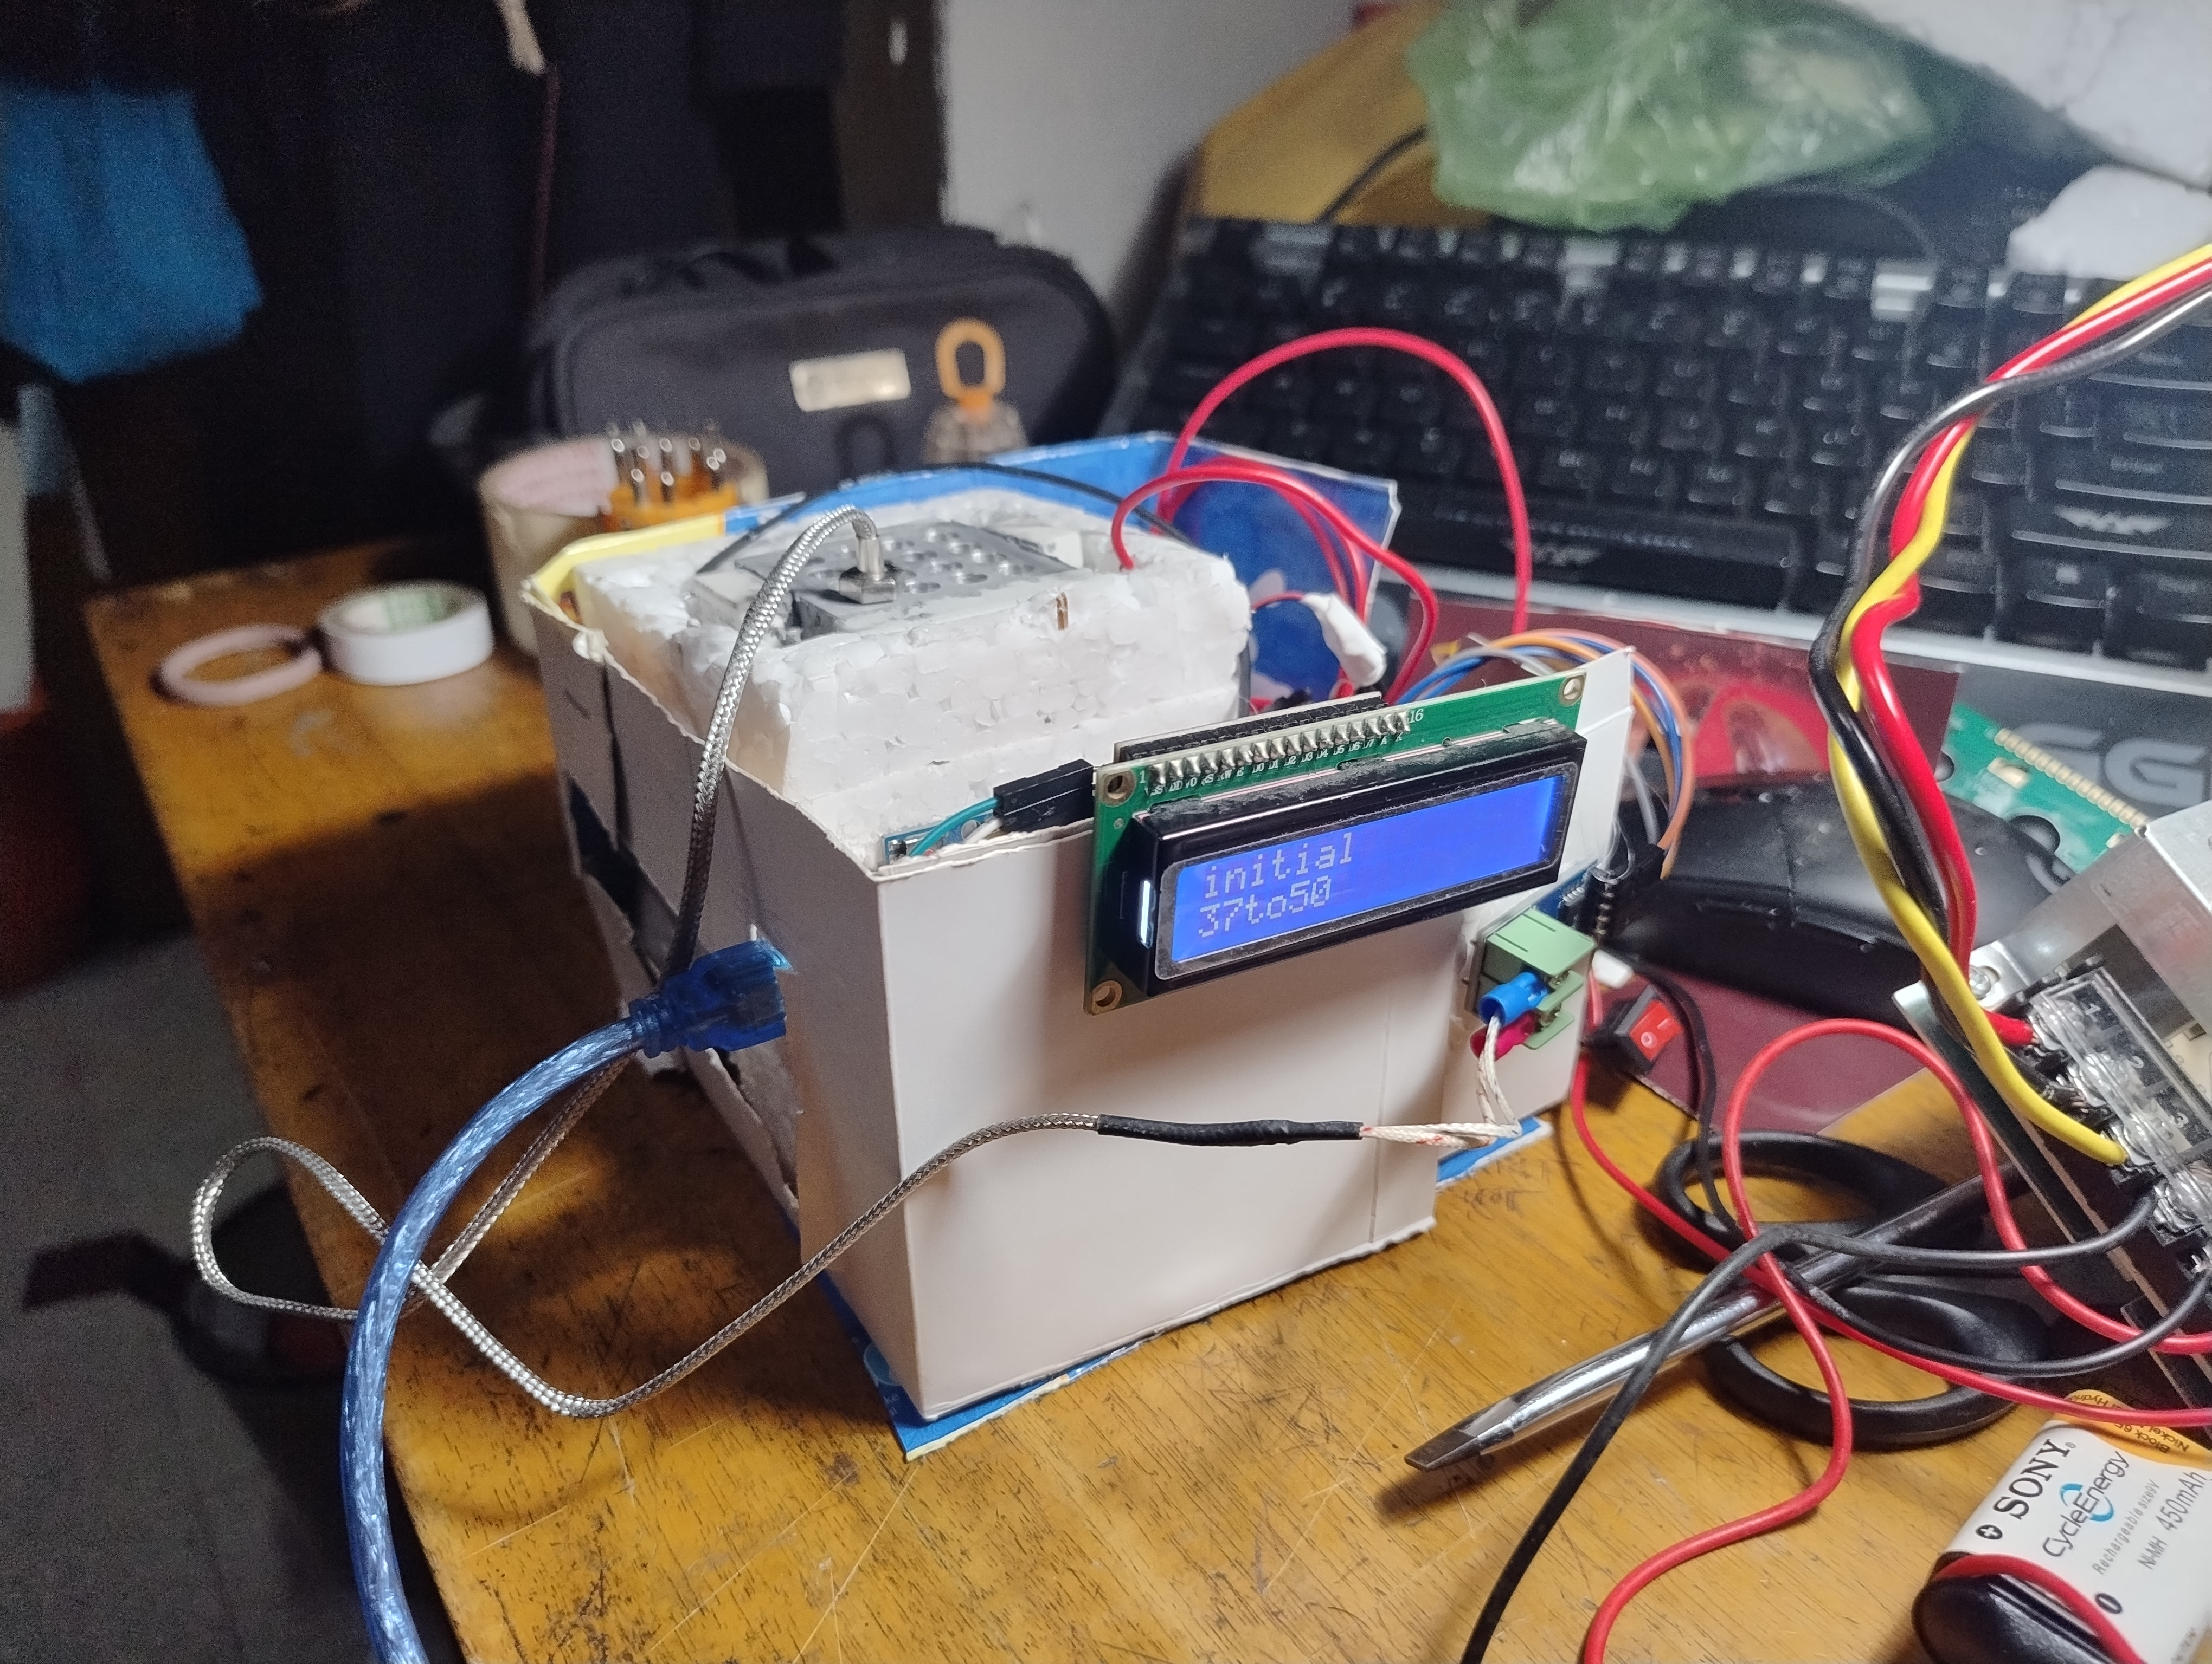
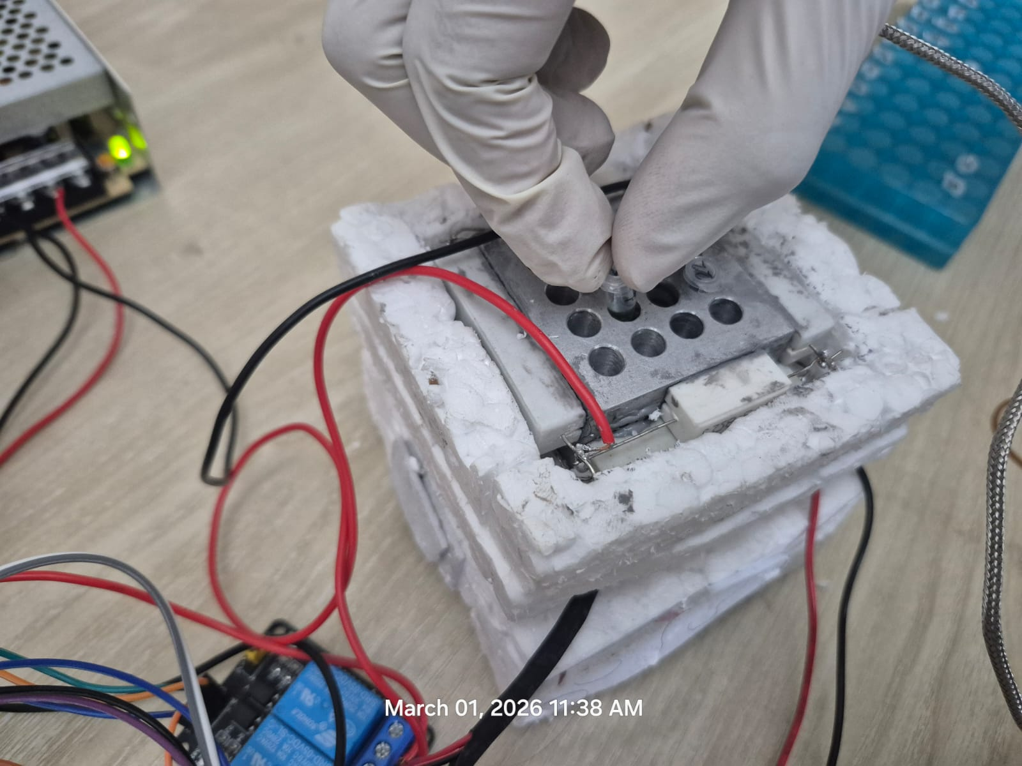
4. Implementation : Demonstration

Slide 14
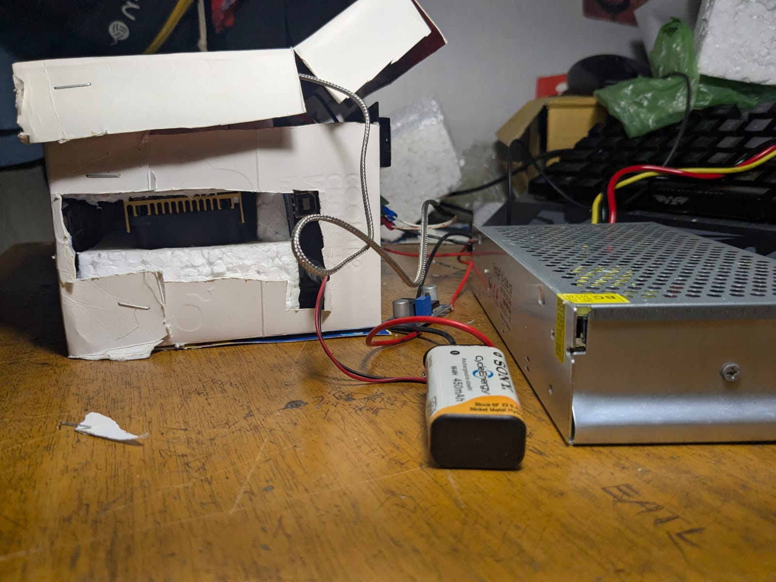
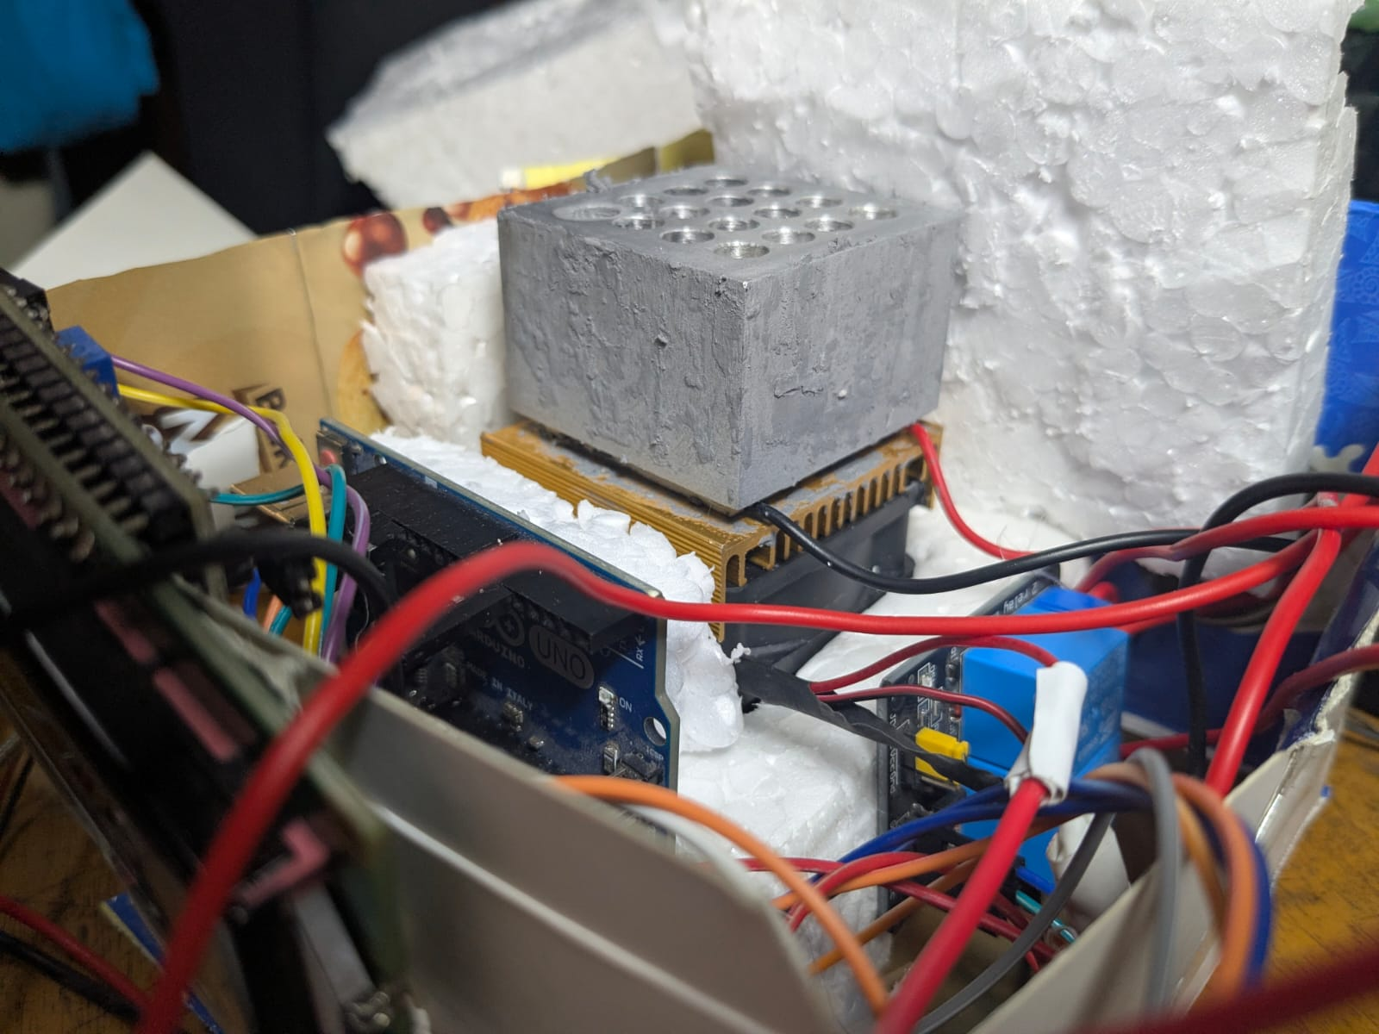
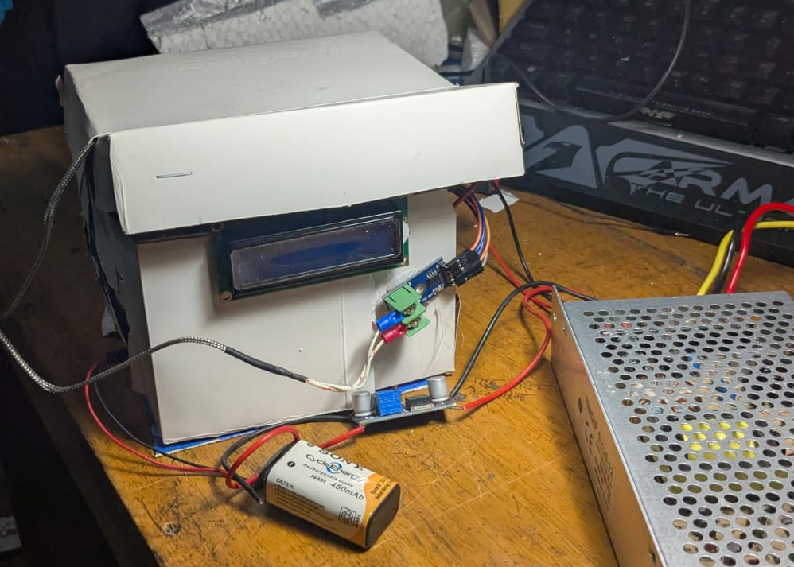
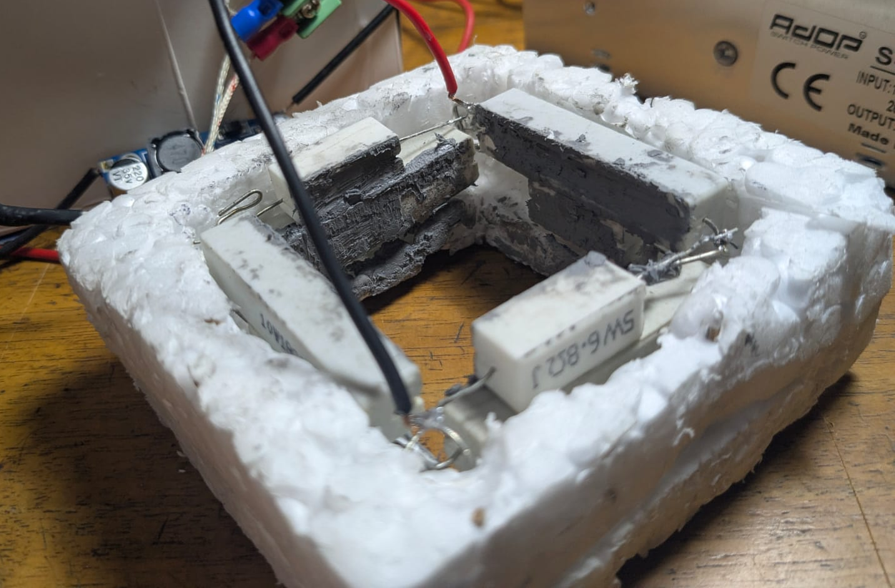
4.1 Implementation: Photo Gallery

Slide 15
4.2 Implementation: External Links
GitHub link:
pcr-thermal-cycler
YouTube Link:
thermal cycle

Slide 16
5. Analysis and Evaluation
5.1 Novelty
5.2 Project Management and Cost Analysis
5.3 Practical Considerations of the Design
5.4 Assessment of the Impact of the Project
5.5 Evaluation of the Sustainability
5.6 Lab Test and Result

Slide 17
5.1 Novelty
We were successfully able to achieve some reaction despite having low cost from the commercial one.
We can provide the working procedure to make this into a DIY project
We can also test this product for various applications aside from just PCR. (Any reaction that depends on a thermo cycler)
We can also ultimately make a manufacturing media where people can work and learn.

Slide 18
5.2 Project Management and Cost Analysis
Product Name | Unit | Price-
Aluminum Thermal Block | 1 | 6000/-
SMPS 12V 10A | 1 | 870/-
Rechargeable 9V Battery | 1 | 360/-
Buck Converter | 1 | 220/-
High Power Resistor (10Ω) | 2 | 20×2 = 40/-
High Power Resistor (18Ω) | 2 | 18×2 = 36/-
High Power Resistor (6.8Ω) | 4 | 10×4 = 40/-

Slide 19
5.2 Project Management and Cost Analysis
Product Name | Unit | Price-
Thermoelectric Cooler | 1 | 465/-
12V DC Fan | 1 | 150/-
Heatsink | 1 | 70/-
MAX6675 Module And K Type Thermocouple | 1 | 380/-
2-Channel Relay Module | 1 | 130/-
Arduino Uno | 1 | 950/-
LCD Display 16×2 | 1 | 240/-
I2C LCD Adapter | 1 | 70/-

Slide 20
5.2 Project Management and Cost Analysis
There was some extra cost during the Research and Development Process of the project as some product was broken or destroyed by failure. And some product was used initially but later discarded.
There were also some miscellaneous cost by the associated accessories i.e. soldering, wire, thermal paste, glue gun, etc.
The cost finally comes downs to 10,021/- Taka for a working prototype which very much less than the commercial product (about 1.5 lakh Taka)

Slide 21
5.3 Practical Considerations of the Design
This product is environment friendly but due to some heating loss it can sum up to global warming
This product is used by educated scientist with caution and no amount hazard can be caused by it.
This product mainly needed in biomedical field but its application ultimately benefits all mankind.

Slide 22
5.4 Assessment of the Impact of the Project
5.4.1 Societal Issues: PCR technology supports disease diagnosis and public health. A low-cost system can improve accessibility, but inaccurate results may negatively impact patient outcomes.
5.4.2 Health & Safety Issues: High operating temperatures and electrical components require proper insulation, grounding and safe handling to prevent burns and electrical hazards.
5.4.3 Legal Issues: Clinical use requires regulatory approval, proper calibration, and compliance with medical device standards before deployment.
5.4.4 Cultural Issues: Genetic testing may raise ethical and cultural sensitivities; responsible use and proper interpretation of results are essential.

Slide 23
5.5 Evaluation of the Sustainability
5.5.1 Evaluation of Sustainability: The prototype uses energy-efficient DC heating and reusable components, reducing operational cost and material waste.
5.5.2 Impact in Societal Context: A low-cost PCR system can improve access to diagnostic tools in resource-limited areas, supporting public health and education.
5.5.3 Impact in Environmental Context: Design minimizes electronic waste by using standard, replaceable components and avoids excessive energy consumption, reducing environmental footprint.

Slide 24
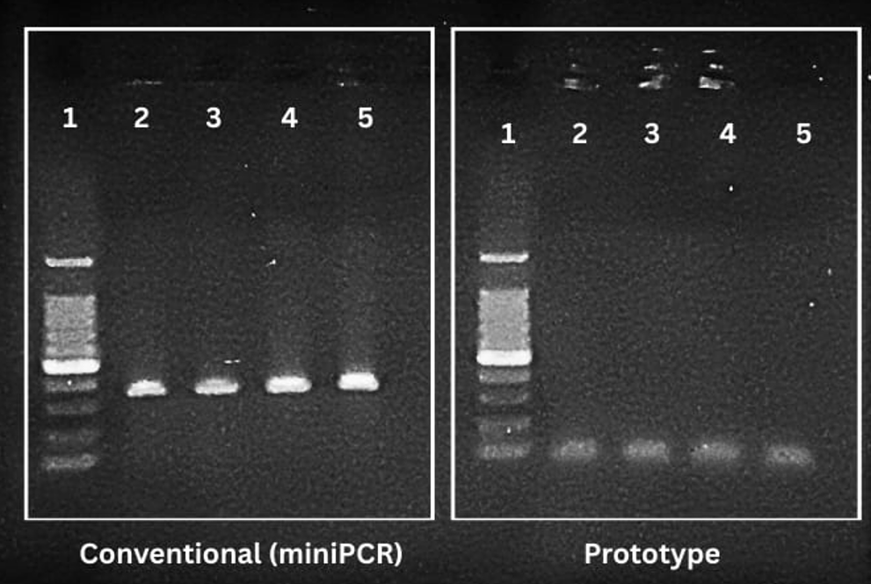
5.6 Lab Testing & Result

Slide 25
5.6 About Result
The prototype PCR machine successfully amplified DNA, demonstrating that the system is functional.
The expected product was 353 bp, but the prototype generated ~100 bp bands, indicating a temperature calibration issue.
Band intensity was lower than the commercial system, but no significant non-specific smearing was observed.
Cycle completion and repeatability were successful, confirming operational stability.

Slide 26
6. Reflection on Individual and Team work
6.1 Individual Contribution of Each Member
6.2 Mode of Team Work
6.3 Diversity Statement of Team
6.4 Log Book of Project Implementation

Slide 27
6.1 Individual Contribution of Each Member
ID | Contribution
220021308 | Design and construction of the Aluminium block, Design and implementation of the power supply circuit, electrical soldering, Liaison to biomedical lab, final testing.
220021115 | Design of the Hardware Setup and the control circuit, Software logic and algorithm development, final testing.
220021104 | Collection of materials, construction of the setup and the control circuit, research and calculations of parameters, final testing.
220021116 | Documentation and presentation, construction of the setup and the control circuit, debugging and optimization, final testing.
220021152 | Design and implementation of the power supply circuit, construction of the setup and the control circuit, management and budget, final testing.

Slide 28



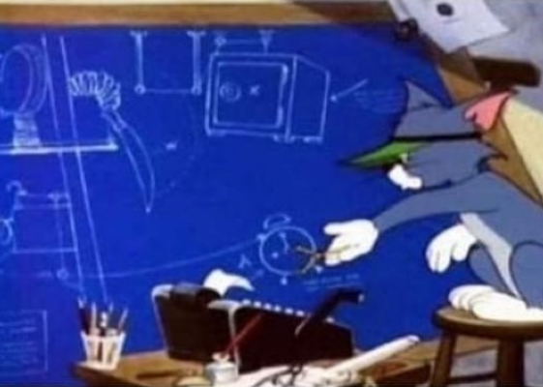
6.2 Mode of Team Work and Diversity
Our team has people from many different skills. Some of us have better understanding of the electrical components and connections, others have a better understanding for the logic and software. Many aspects of the project would not work without the research and understanding of the process from all of our team members.
Though there ere a few hurdles in the way we successfully completed the device as we wanted
In the end we had fun working with each other specially with the fact that testing this machine
requires us to wat a long time.
Testing the PCR
Making the PCR machine

Slide 29
6.3 Logbook of Project
Research & Planning (Studied PCR thermal cycling principles, analyzed temperature requirements, selected core components such as SMPS, thermocouple, resistive heaters, and Arduino platform)
System Design (Designed aluminum heating block, developed temperature control logic, planned AC-based initial power configuration)
Implementation (Integrated resistive heating elements, embedded thermocouple, assembled SMPS power supply, programmed thermal cycling parameters)
Problem: Temperature Instability (Observed unstable temperature control in AC-based system leading to conversion to fully DC operation for improved stability)
Problem: SMPS Failure (Accidentally damaged initial SMPS during early testing due to inexperience, replaced with new unit and implemented safer power-up procedure)
Problem: Thermocouple Inaccuracy (Detected deviation in temperature readings, performed calibration and offset correction for improved measurement accuracy)
Problem: Resistance issues (During testing many resistances got damaged due to thermal and mechanical distress, they had to be replaced with other value resistances)
Debugging & Optimization (Performed repeated temperature validation tests, tuned control parameters, improved thermal contact and heat transfer efficiency))
Testing & Evaluation (Conducted 35-cycle PCR test, performed gel electrophoresis comparison, analyzed amplification deviation and system performance metrics)
Laboratory Validation (Tested prototype under real laboratory conditions to assess repeatability, thermal accuracy, and practical usability)

Slide 30
7. References
https://www.instructables.com/Arduino-PCR-thermal-cycler-for-under-85/
https://pmc.ncbi.nlm.nih.gov/articles/PMC10021165/
https://www.labmanager.com/understanding-thermal-cyclers-an-introduction-and-overview-31635

